Slide 1
Complete 540 Phase 2 Roadside Support System RFP
Mandatory Pre-Proposal Scope of Services Meeting
March 18, 2026, 1:00 p.m. – 2:00 p.m. ET
Online via Web conference

Slide 2
Roll call for one person by company
PLEASE MUTE YOUR LINE IF YOU ARE NOT SPEAKING

Slide 3
Welcome and Introductions
Eliza Davis

Slide 4
NCTA Staff Meeting Introductions
Name | Job Title
Eliza Davis | Procurement Specialist II
Sybil Lattimore | Receptionist
Manish Chourey | Chief Technology Officer

Slide 5
Pre-Proposal Meeting Details
Post questions via chat and they’ll be addressed at the end of this presentation.
All verbal comments and responses are non-binding.
Questions shall be made in writing if a formal response is requested.
A copy of this presentation will be posted on the NCTA website at: https://connect.ncdot.gov/business/Turnpike/Pages/C540P2RFP.aspx

Slide 6
Agenda
Project Introduction & Procurement Goals
Overview of Procurement Process
Scope of Work and Requirements
Complete 540 Phase 2 Project Timeline
Questions and Answers/Closing Remarks

Slide 7
Project Introduction & Procurement Goals
Manish Chourey

Slide 8






Program Descriptions
NCDOT
North Carolina Department of Transportation
Responsible for all modes of transportation in NC such as highways, rail, aviation, ferries, DMV, etc.
NCTA
North Carolina Turnpike Authority
A department of NCDOT. Responsible for all toll projects in NC.
NCQP
NC Quick Pass
NCTA’s public-facing brand for tolling and toll collection once a toll project opens to traffic.

Slide 9
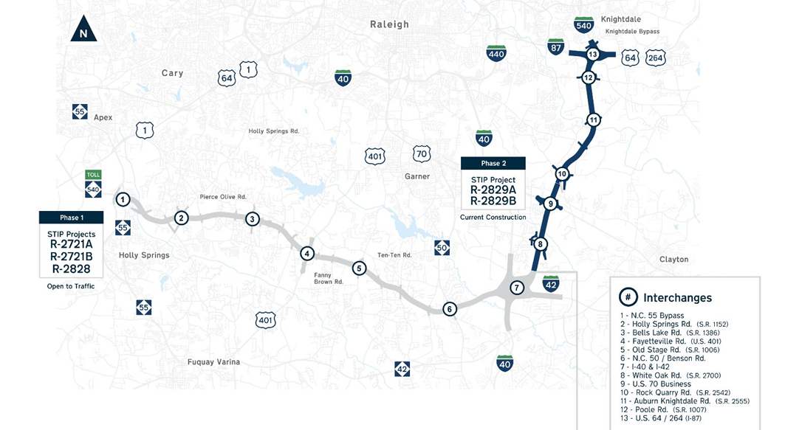
Complete 540 Phase 2 Location Map
I-485 RTCS Express Lanes Project - Pre-Proposal Scope of Services Meeting

Slide 10
Complete 540 Phase 2 Roadside Support System RFP Goals
Deploy a modern toll collection system using a single overhead gantry with no in-pavement sensors for detection or classification.
Implement an AVI system aligned with RTCS needs, using only approved E-ZPass certified equipment.
Minimize physical infrastructure for toll collection system deployment.
Deliver a scalable, modular system that can integrate with evolving technologies.
Provide a highly resilient system architecture.
Optimize efficiency with a lightweight Transactions Reconciliation Host (TRH).

Slide 11
Overview of Procurement Process
Eliza Davis

Slide 12
RFP Content
Part I: Administrative
Part II: Defined Terms and Acronyms
Part III: Scope of Work and Requirements
Part IV: Proposal Content
Part V: Terms and Conditions

Slide 13
RFP Materials
4 PDF packages found on the NCTA Website for download: https://connect.ncdot.gov/business/Turnpike/Pages/C540P2RFP.aspx
  RFP
  Exhibits
  Attachments
  Appendices
Attachments & Appendices both include supporting documentation to the RFP.
Exhibits include forms that are to be filled out and submitted with proposal submissions.
  See RFP Part IV, Section 1.1. & Section 2.1 for the proposal forms and submittal checklists.

Slide 14
Procurement Schedule
Category | Date
RFP Issued | March 9, 2026
RSVPs Due for Mandatory Pre-Proposal Meeting | March 17, 2026 (4:00 p.m. ET)
Mandatory Pre-Proposal Scope of Services Meeting | March 18, 2026 (1:00 p.m. to 2:00 p.m. ET)
Proposer Questions Due | March 25, 2026 (4:00 p.m. ET)
NCTA Response to Questions | April 9, 2026
Technical Proposals Due | May 4, 2026 (4:00 p.m. ET)
Notification of Proposers Shortlisted | June 5, 2026
Oral Interviews & Presentations | Week of June 22, 2026
Price Proposals Due (ONLY Shortlisted Proposers will submit a Price Proposal) | July 7, 2026 (4:00 p.m. ET)
Ranking of Shortlisted Proposers for Negotiations | Week of July 13, 2026
Notice of Award | Week July 20, 2026
NCTA reserves the right to modify the schedule at any time and for any reason.

Slide 15
Proposer Questions
Due March 25, 2026, by 4:00 p.m. ET
All questions and comments to be submitted using Exhibit C-4: Proposer Questions Form.
All questions and comments must be submitted via emailed to: ncta_c540p2_rfp@ncdot.gov
NCTA will provide responses April 9, 2026, and publish Addenda, if required.

Slide 16
Technical Proposal Submittal and Evaluation
Due May 4, 2026, by 4:00 p.m. ET
  Refer to RFP Part IV, Section 1 for Technical Proposal content and format instructions.
Once Technical Proposals are received, they will go through preliminary evaluation and scoring. If a Technical Proposal scores below 70 out of 100 points during preliminary scoring, it will be considered non-compliant and will not be considered further.
Proposers who score above 70 during preliminary evaluation and scoring may be eligible to be shortlisted. The top-ranked shortlisted Proposers will be invited to participate in oral presentations and interviews.

Slide 17
Technical Proposal Scoring
I-485 RTCS Express Lanes Project - Pre-Proposal Scope of Services Meeting
Technical Proposal Sections | Maximum Possible Points
Section 1: Proposer Qualifications | 5
Section 2: Key Team Qualifications | 5
Section 3: Approach to Scope of Work and Requirements | 35
Section 4: Approach to Project Plan, Implementation, Interfaces, and Testing | 30
Section 5: Approach to Operations & Maintenance | 20
Section 6: Adherence to the Scope of Work & Requirements, T&Cs, and Requirements Conformance Matrix | 5
Maximum Possible Technical Points | 100

Slide 18
Price Proposal Submittal and Evaluation
Due July 7, 2026, by 4:00 p.m. ET
  ONLY the top-ranked shortlisted Proposers will submit a Price Proposal.
Refer to RFP Part I, Section 4.5 for price review and scoring details.

Slide 19
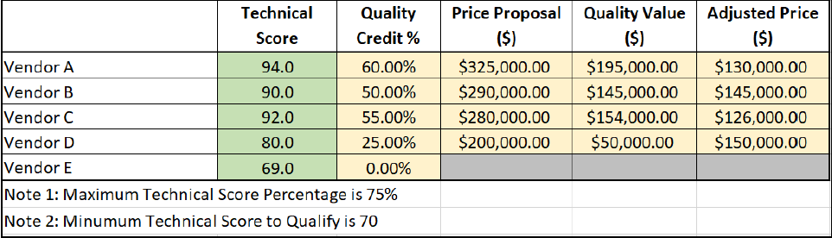
Best Value
Calculating Lowest Adjusted Price
Step 1: After Price Proposals are reviewed, NCTA may request written clarifications.
Step 2: After written clarification responses, each top-ranked shortlisted Proposer will receive a quality credit percentage based on their final technical proposal score.
  See Table I-3 in the RFP for each technical score quality credit percentage.
Step 3: Each top-ranked shortlisted Proposer’s Quality Credit % and Price Proposal $ amount will be entered into the below table to calculate the lowest adjusted price.
Step 4: The successful Contractor is the one with the lowest adjusted price.
  In the example below, Vendor C is the successful Contractor.

Slide 20
Submittal Delivery
Submittals (both Technical Proposal & Price Proposal) shall be delivered to:
NCTA
2501 Aerial Center Parkway, Suite 200
Morrisville, NC 27560
Attn: Eliza Davis
Refer to RFP Part IV, Section 1.3 & 2.3 for further instructions on submissions.
  NO hard copies; only electronic submissions on a USB flash drive.

Slide 21
Non-Solicitation Provision
Non-solicitation in accordance with RFP Part I, Section 2.3.
ONLY contact NCTA in the manner identified in RFP Part I, Section 1.4.
A violation may be grounds for rejection of the proposal.

Slide 22
Scope of Work & Requirements
Overview
Manish Chourey

Slide 23
Scope of Work Requirements
Roadside Support System Project, Design, Testing and Implementation Documentation Requirements (1-198)
  Details the requirements for project execution and how the Proposers must document their approach to meet them.
RTCS Functional Requirements (199-375)
  Details all functional requirements for lane function, host function, data reporting and retention and external interfaces.
Maintenance Responsibilities & Services (376-462)
  Details all monitoring, preventive maintenance, corrective maintenance and related elements required during the Maintenance and Operations Phase of the Project.
  Performance Requirements – Maintenance & Operations (463-510)
    The Contractor shall design and build the system to meet these requirements.
    A summary of the Performance Requirements can be found in RFP Table III-2: Monthly Performance Requirements

Slide 24
Summary of Changes in Scope of Work
Implementation Phase to end at Onsite Installation Test.
New NTP at start of Installation (with notice period) for Installation, Commissioning and Go-Live through System Acceptance.
Contractor to provide Transaction Reconciliation Host (TRH) to interface with NCTA OBO.
Image Verification Services have been removed from the scope. OCR is required for all (AVI and Image) transactions.
NCTA OBO will perform Secondary OCR and Image Verification Services.
Additional construction information available for toll site information and wrong-way vehicle detection systems.

Slide 25
Scope of Work
Key Personnel
Roles | Responsibilities
Project Principal | Overall conduct & performance of the Project. POC for any escalated issues that can’t be resolved by the Contractor Project Manager.
Contractor Project Manager | All day-to-day work. Overall execution & delivery of the Project.
Technical Manager | Overall RTCS solution architect. Manage design, development & implementation of the technology solution & resources related to the RTCS & interfaces to NCTA provided OBO.
Installation Manager | Installation & commissioning of the RTCS & external interfaces.
Maintenance Manager | Maintenance services of the RTCS & external interfaces.
Quality Assurance Manager | Consistent quality throughout design, development, testing & implementation of the Project.
Test Manager | Overall planning & implementation of the Project’s testing program.

Slide 26
Attachments
I-485 RTCS Express Lanes Project - Pre-Proposal Scope of Services Meeting
Attachment | Description
1. NCQP Business Policies | This document contains the business policies by which the NCTA operates its NC Quick Pass® toll collection program.
2. State of NC, Statewide Info Security Manual | Provides the statewide security policy for North Carolina State Agencies. Establishes principles to ensure a secure network infrastructure.
3. Design Build Contracts | NCTA contracts with the design build teams constructing the facility; provided for reference.
4. Infrastructure Design Drawings | NCTA Standard Drawings for Expressway Toll Zone Infrastructure. Note: Detailed drawings from the design build teams will be provided later.
5. Project Responsibility Matrix | Matrix of stakeholder responsibilities for the implementation and maintenance of the toll facility.
6. OBO ICD | The interface specifications for the data exchange between RTCS and OBO. Note: This document is in draft form; to be finalized during the design phase.
7. Lane Closure Restrictions | Initial lane closure restrictions once the facility begins to operate with traffic. Note: Subject to change based on observed traffic volumes.
8. Future Transaction Projections | Projected traffic statistics for the first 14 years of toll system operations from the NCTA Traffic and Revenue Study completed in 2024. Note: These values are estimates, so Proposers should apply conservative factor of safety when used.
9. KPI Guidebook | Instruction on how to measure the KPI's outlined in the RFP requirements. Any deviation from these methods is subject to NCTA review and approval.
10. Preventative Maintenance Checklist | A high-level list of the preventative maintenance activities required for the Project.

Slide 27
Complete 540 Phase 2 Project Timeline
Manish Chourey

Slide 28
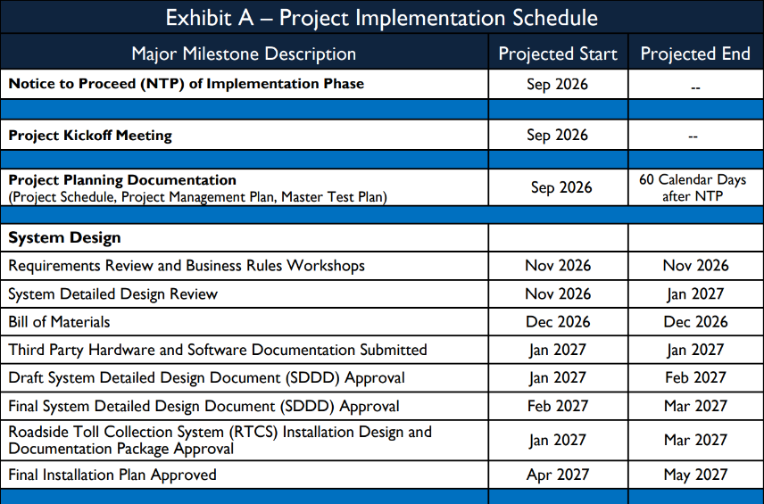
Project Implementation Schedule – Part 1

Slide 29
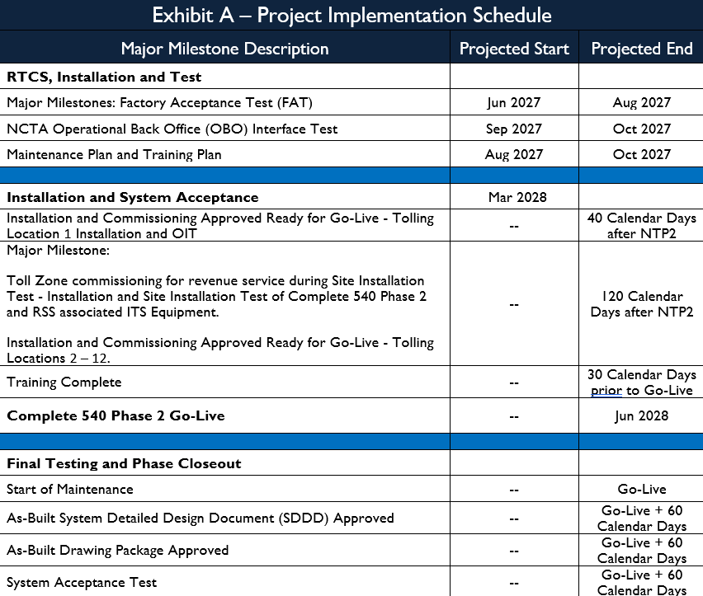
Project Implementation Schedule – Part 2

Slide 30
Contract Term
The term of the Contract will commence at Notice of Award based on Project Phases below:
The Project Phases are:
  Implementation Phase
    Commences upon issuance of Implementation Phase Notice of Award and ends upon System Acceptance.
  Operations & Maintenance Phase
    Commences upon Go-Live and shall continue through the end of the base Contract Term for a period of up to five (5) years.
  Optional Extension Phase
    Includes two (2) optional three (3)-year Maintenance extensions to be executed at the sole discretion of NCTA, with the first extension commencing upon the end of the base Contract Term.

Slide 31
Questions & Answers
Please post your questions in the chat

Slide 32

Closing Remarks
Eliza Davis
Point of Contact
Email: ncta_c540p2_rfp@ncdot.gov

